Slide 1
SustainaBOWL
Matt Mattera

Slide 2
The Narrative
My persona is a 19 year old college student living on their own for the first time. While they’ve been grocery shopping with their parents before, they’ve never gone by themselves, so they always end up overbuying. They need some type of solution to mitigate their waste problem. They try our app, SustainaBOWL to track their grocery habits and try and fix them.

Slide 3
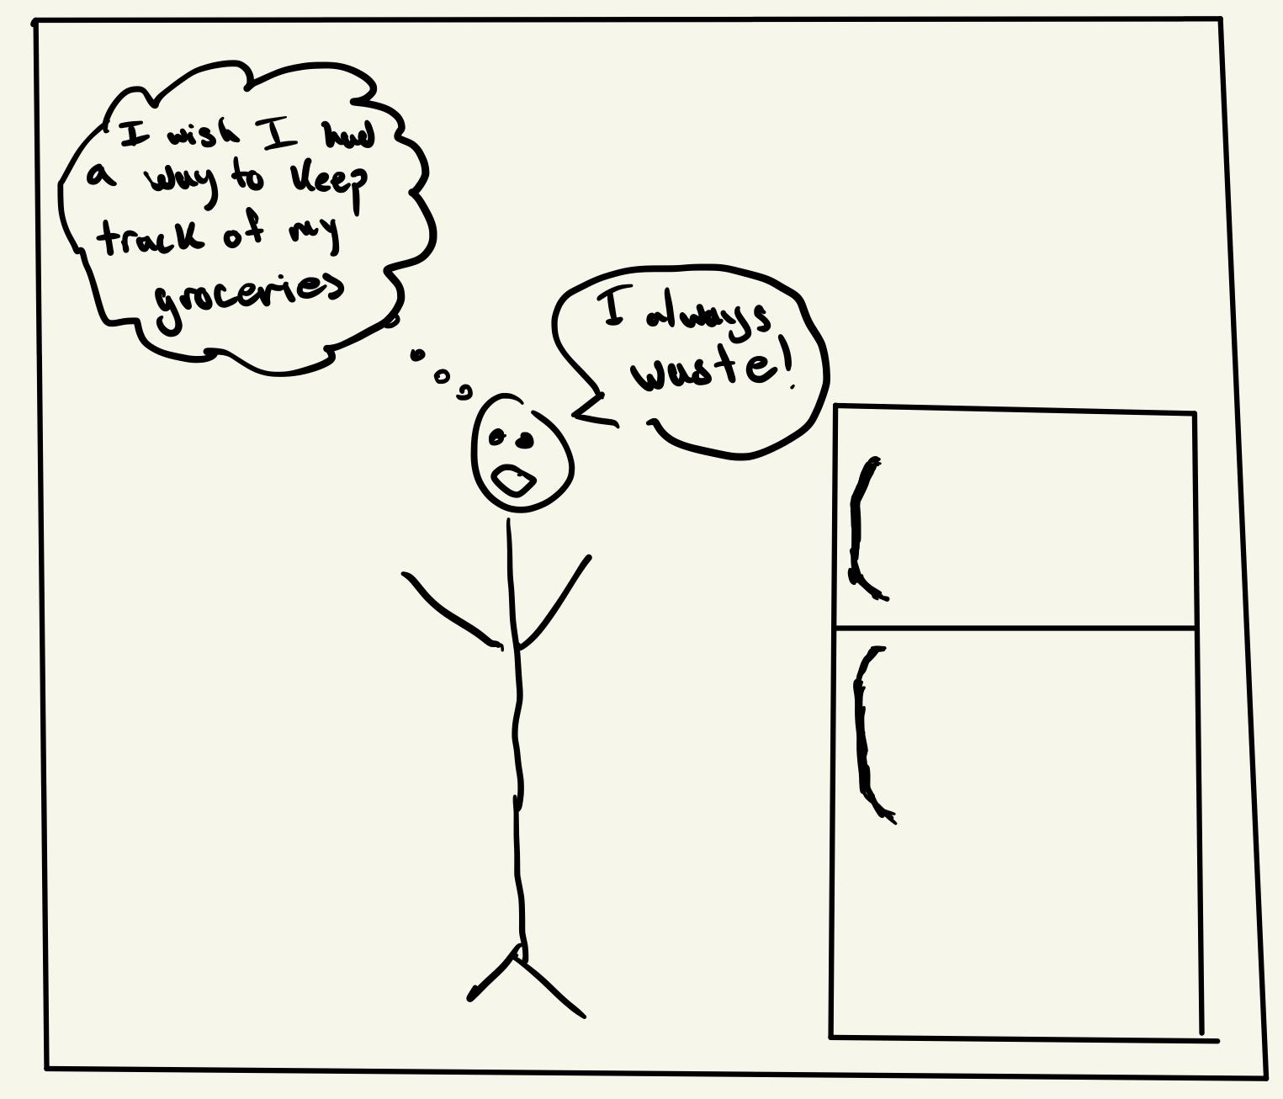
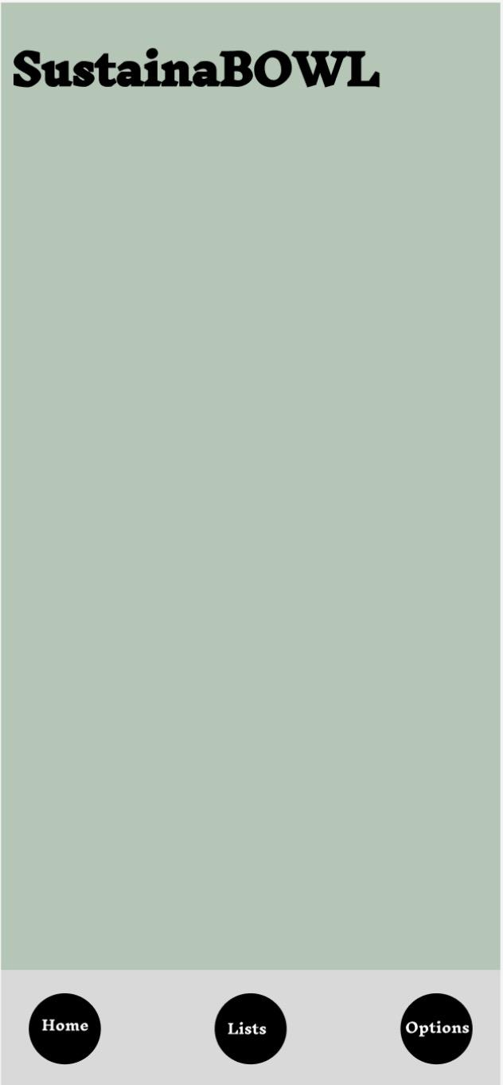
Scene 1
Find a Recipe
Make My List
See My Waste
This scene shows the persona contemplating how to track their groceries so they waste less.

Slide 4
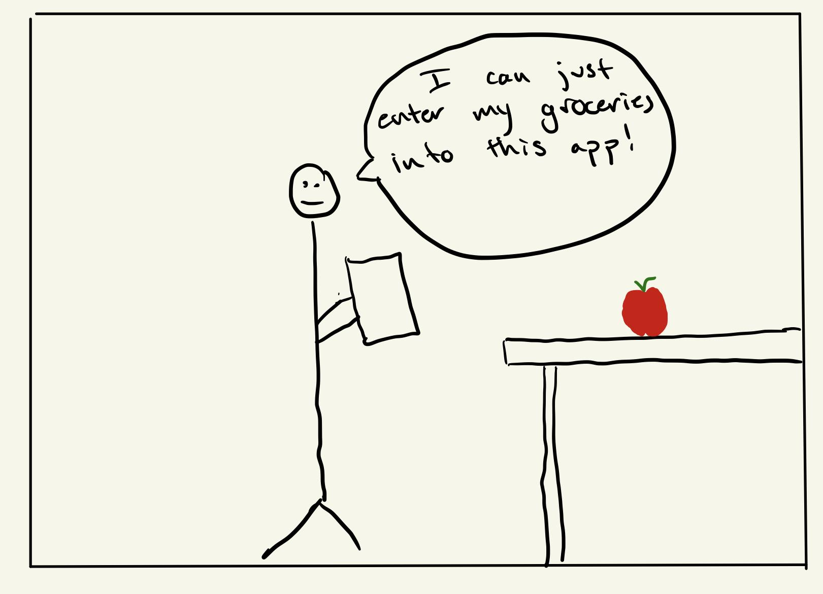
Scene 2
Chicken
Rice
Peppers
Onions
+ Add to List
This scene shows how our app allows users to add groceries to a list in the app.

Slide 5
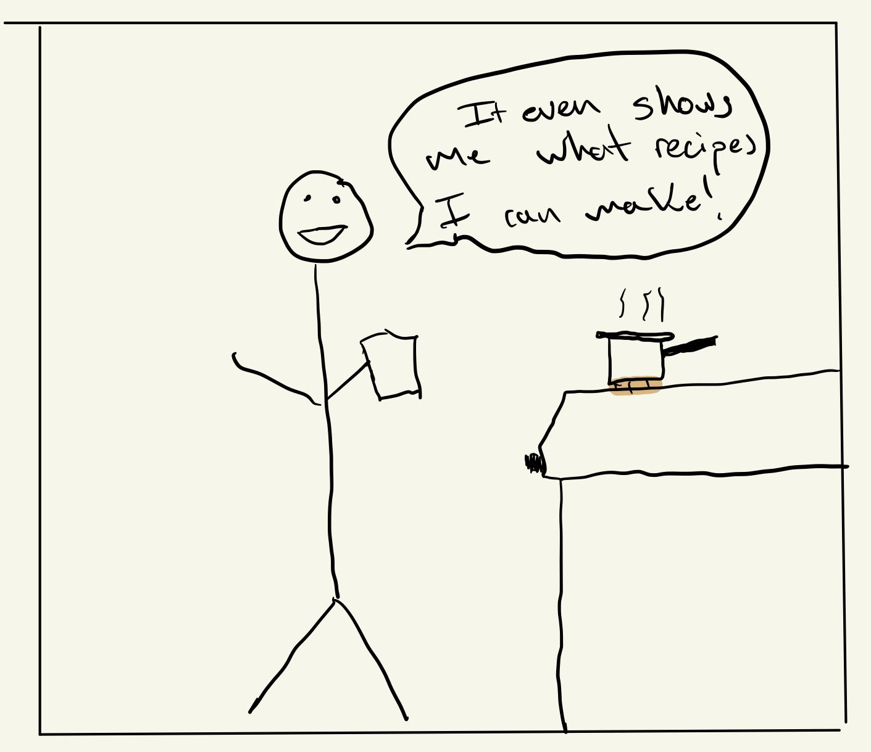
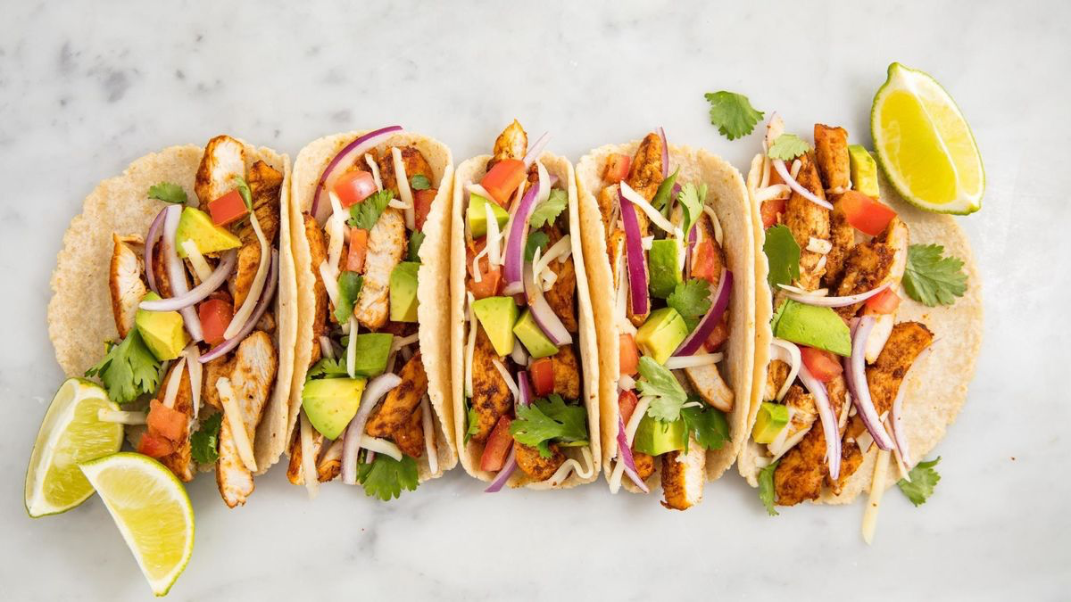
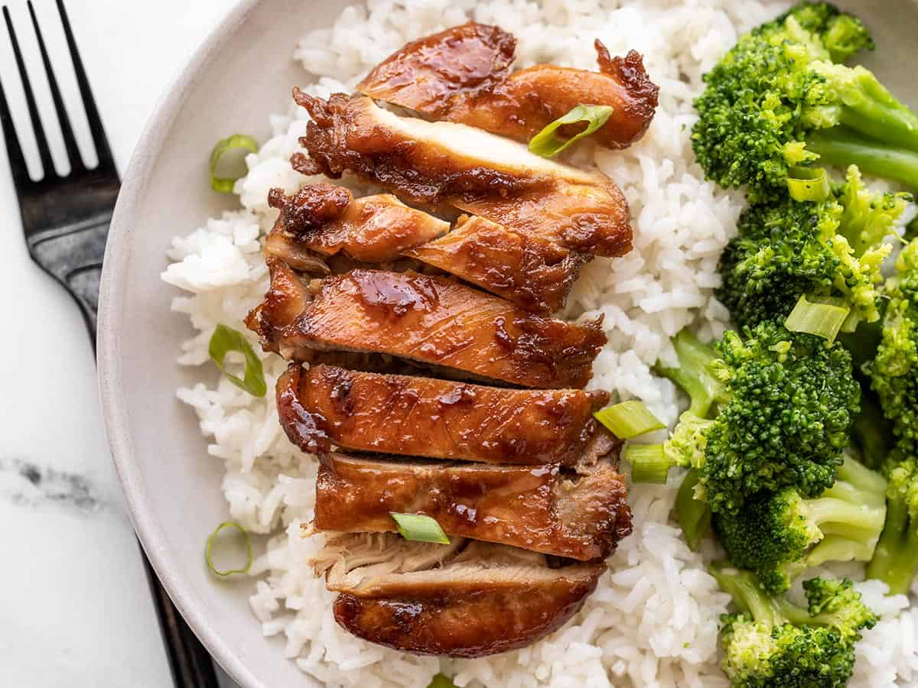
Scene 3
You Can Make:
Tacos
Teriyaki Chicken and Rice
This scene shows how the app will recommend recipes based on the ingredients the user is buying.

Slide 6
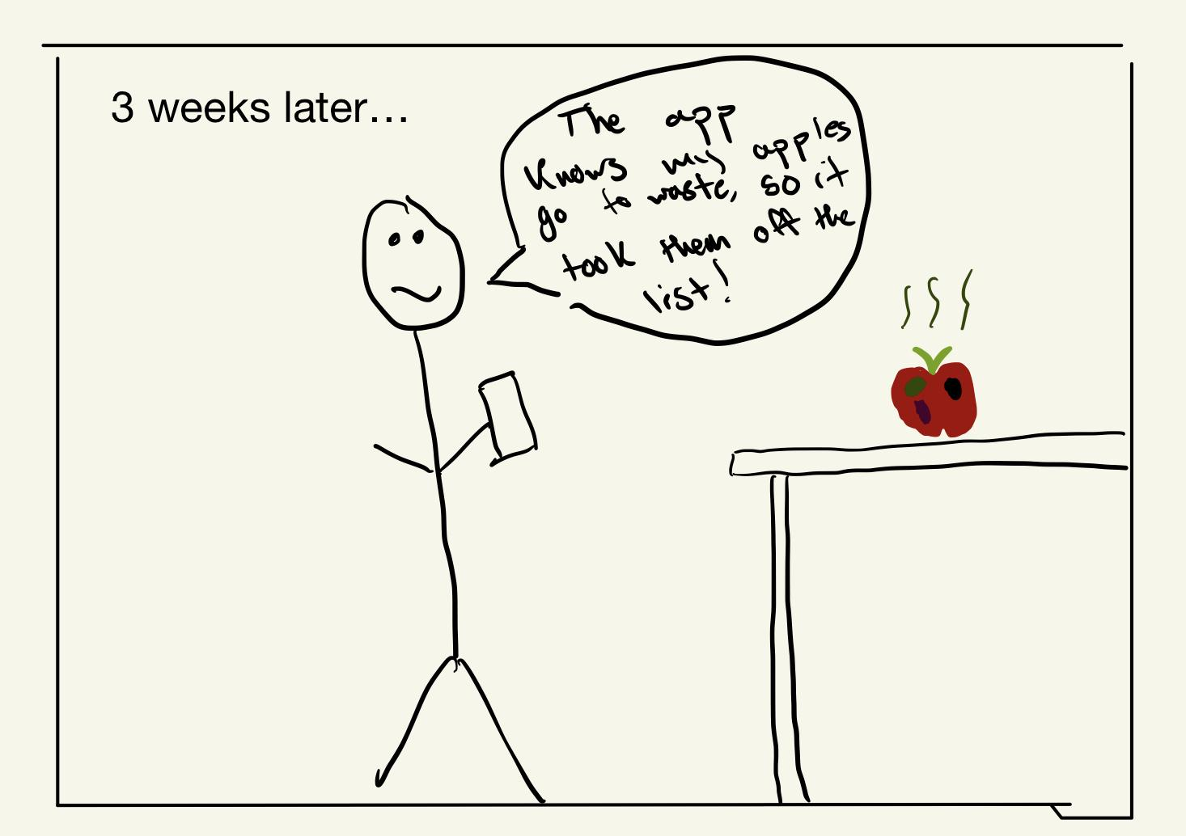
Scene 4
You usually waste:
Apples
Cheese
Steak
Don’t buy these anymore!
This scene shows how the app will track the wasted groceries (based on user input) and recommend that they not buy again.

